Slide 1

Valuation of Zepto Using DCF & Monte Carlo Simulation
By: Kiran Kumar | MBA in Finance & Business Analytics
Tools: Excel + R | Industry: Quick Commerce | Year: 2025
Notes:
1

Slide 2
Executive Summary: Zepto Valuation
DCF Model
Monte Carlo Simulation
Projected FCFF till FY28 for a base valuation.
1,000 iterations for a robust valuation range.
Valuation: ₹18,410 Cr
Median: ₹18,559 Cr
Range: ₹8,300 Cr – ₹51,400 Cr
There is a 75% probability of Zepto's valuation exceeding ₹14,000 Cr.
Notes:
2

Slide 3
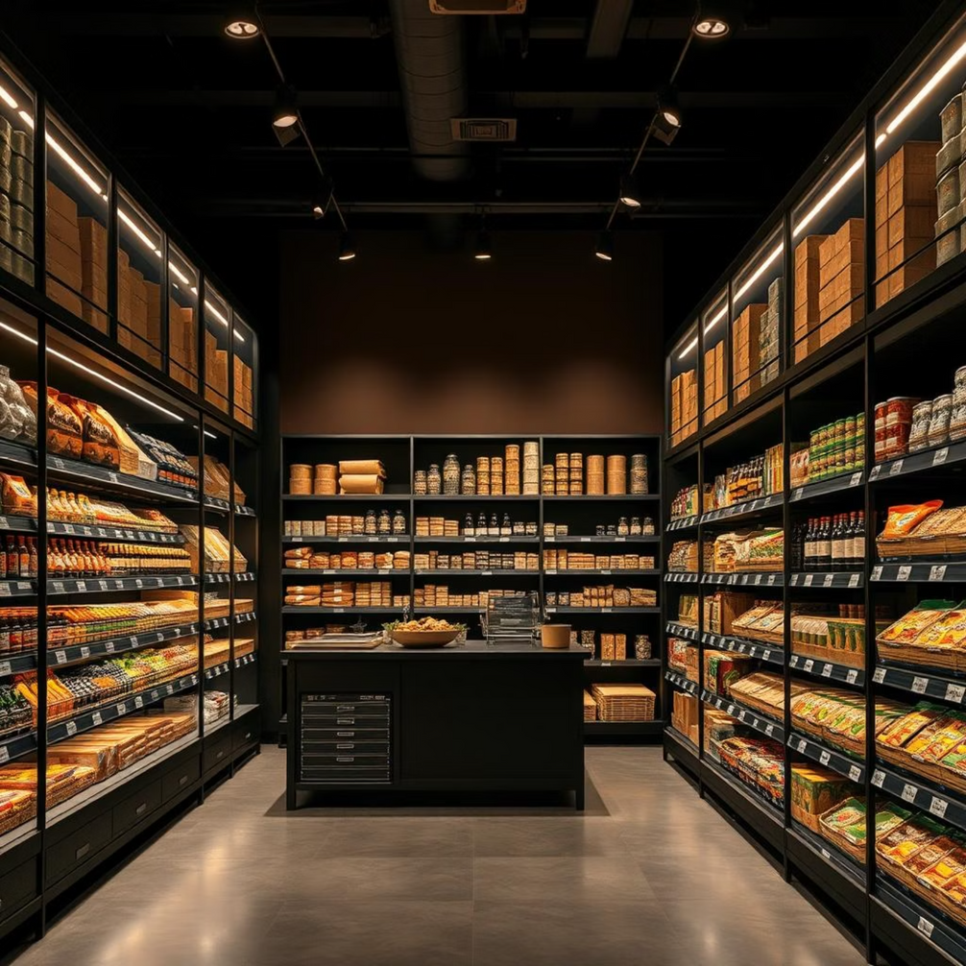
Industry & Company Snapshot
Quick-Commerce Sector
10-minute delivery model.
Indian Q-Commerce CAGR: 25–35%.
Zepto Overview
Founded: 2021
Current Valuation: $1.4B (₹11,000 Cr)
Investors: Nexus, Glade Brook, StepStone
Operates via dark-store + B2C mobile delivery.
Notes:
3

Slide 4
DCF Assumptions & Revenue Forecast
Metric
Value
Base Revenue (FY23)
₹2,024 Cr
Revenue in FY28
₹17,682 Cr
EBITDA Margin (FY28)
10%
WACC
10%
Terminal Growth Rate
5%
CapEx (over 5 years)
₹700 Cr
Depreciation
5% of Revenue
WC Changes
5% of Revenue
These assumptions drive the projected Free Cash Flow to Firm (FCFF) for Zepto.
Notes:
4

Slide 5
DCF Valuation Summary: FCFF Projections
Year
FCFF (₹ Cr)
PV Factor
PV (₹ Cr)
FY23
-958
0.909
-871.27
FY24
-807
0.826
-667.10
FY25
-150
0.751
-112.69
FY26
+386
0.683
+263.47
FY27
+986
0.620
+612.29
FY28
+1,547
0.564
+873.33
Terminal Value (TV): ₹32,457 Cr
PV of TV: ₹18,312 Cr
Final DCF Valuation: ₹18,410 Cr
Notes:
5

Slide 6

Why Monte Carlo Simulation?
DCF provides a static valuation, lacking clarity on risk.
Monte Carlo performs 1,000 randomized valuations by varying:
FCFF: ±10% noise
WACC: 8%–12%
Terminal Growth Rate: 3%–7%
Tools Used: R, ggplot2, dplyr
Notes:
6

Slide 7
Monte Carlo Simulation Results
₹8,300 Cr
₹51,400 Cr
₹21,227 Cr
₹18,559 Cr
Min Valuation
Max Valuation
Mean Valuation
Median Valuation
The simulation shows a 75% probability that Zepto’s valuation exceeds ₹14,000 Cr.
Notes:
7

Slide 8




Visual Insights from Simulation
Histogram
CDF Curve
Bell curve with a right skew, indicating potential upside.
Confirms 75% probability of valuation > ₹14,000 Cr.
Boxplot & Violin Plot
Sensitivity Heatmap
Reveals a tight median with a wide tail, showing variability.
Low WACC + high growth leads to ₹40K+ Cr; high WACC + low growth leads to ~₹12K Cr.
Notes:
8

Slide 9

Strategic Recommendations
For Investors
For Company
For Board/VCs
Use ₹18,559 Cr (median) or ₹24,700 Cr (75th %ile) as negotiation points.
Communicate upside using the simulation-backed valuation range.
Plan burn rate, hiring, and funding rounds with scenario analysis.
Risk: Valuation drops to ~₹10,700 Cr in 25% of cases. WACC and revenue sensitivity must be managed.
Notes:
9

Slide 10

Conclusion: Zepto's Valuation Outlook
DCF provides a solid base case valuation of ₹18,410 Cr.
Monte Carlo reinforces reliability and identifies a clear confidence range.
Zepto demonstrates strong upside potential with quantified risk.
This simulation acts as a valuation stress test, empowering both investors and management with better decisions.
Notes:
10

